Slide 1
A role of post-transcriptional and post-translational modification for RNA regulation
Elliot Martin
Fuchs and Rangan Labs
Notes:
How modifications on mRNAs and on ribosomal proteins, can affect RNA regulation

Slide 2
Aims
Determine how modifications on mRNA direct their regulation
Identify the enzymes that modify ribosomal proteins to affect translation control

Slide 3
Metazoans have a common lifecycle
Notes:
We want to know how the transition from being an egg to being a zygote occurs

Slide 4
Maternal to zygotic transition is a critical RNA turnover event
Maternally
transcribed
Zygotically
transcribed
RNA
1-Cell
Blastula
Gastrula
Tadros and Lipshitz, Development (2009)
Notes:
One process that occurs in the transition from egg to zygote is maternal to zygotic transition. This is a process where factors deposited into the egg, such as mRNA, are degraded and at the same time, zygotic mRNAs begin to be transcribed
How are these Maternal RNAs are marked for degradation?

Slide 5
Drosophila germ line as a model system to understand RNA regulation
Developmental stages
(ovariole)
Oogenesis
Embryogenesis
Maternal RNA
Notes:
-RNA is deposited into developing oocyte
-fertilized egg is laid
-allows us to easily collect large numbers of embryos for analysis

Slide 6
polar granule component (pgc) is a tightly regulated germline determinant
Pgc Protein
pgc RNA
Oogenesis
Embryogenesis
pgc RNA
Pgc Protein
Nakamora et al., Nature (2008)
Flora et al., in progress
Notes:
Why is it critical that pgc is tightly regulated?

Slide 7
Pgc is a potent transcriptional repressor
Notes:
How is pgc so tightly controlled?

Slide 8
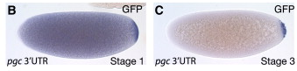
Germline determinants are segregated during development
Time
Notes:
How are germline determinates specifically degraded in the soma?

Slide 9
Germline determinates are degraded or silenced in the soma
m7G
eIF4E
Cup
SMG
Deadenylase Complex
SRE
AAAA
Notes:
Smaug is cleverly named after the dragon from Tolkein’s The Hobbit, because like the dragon, the protein guards its treasure, the soma, and destroys and invading RNAs

Slide 10
Germline determinants are segregated during development
Time
?
Notes:
Smaug only degrades about 2/3^{rds} of unstable maternal RNAs, so what degrades the remaining 3rd?

Slide 11

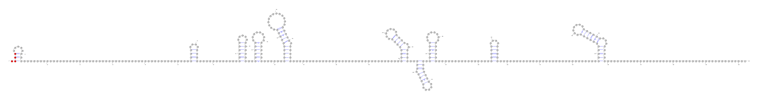
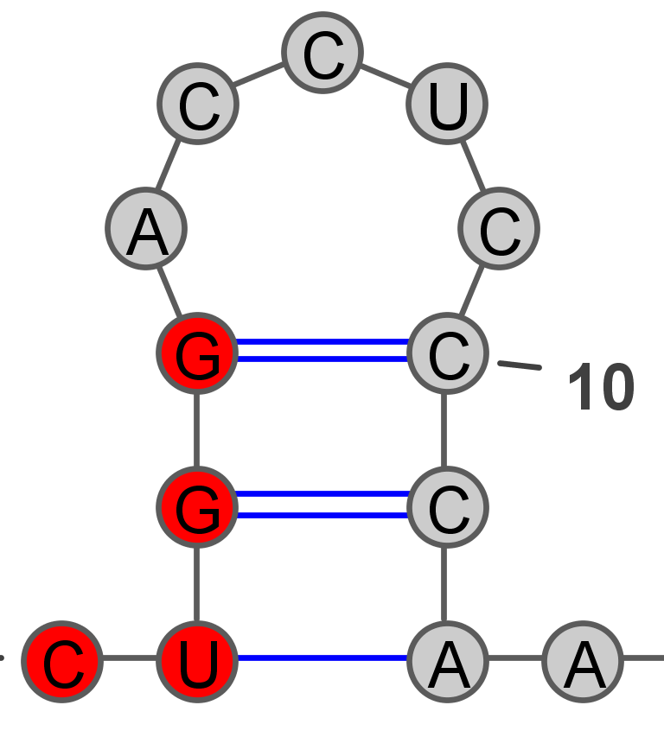
pgc is degraded independently of Smaug
pgc

Slide 12
How is pgc turned over?

Slide 13
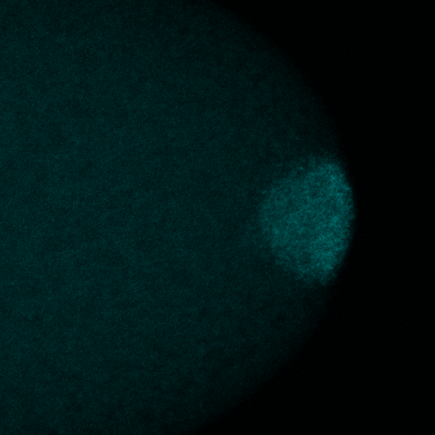
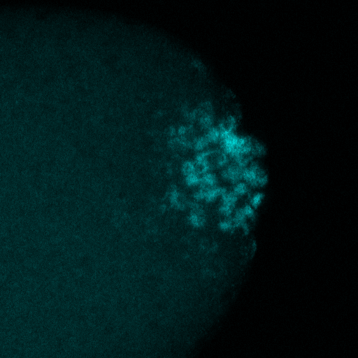
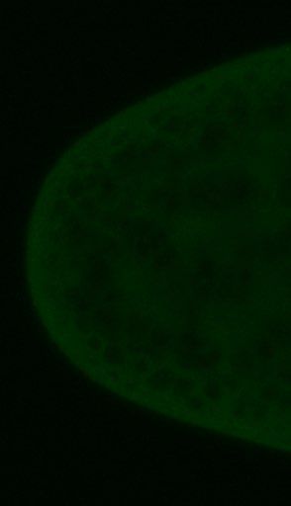
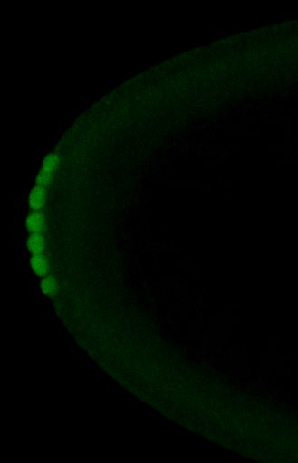
3’UTR is sufficient to control pgc translation
nos 5’UTR
HA
GFP
pgc 3’UTR
Embryogenesis
Reporter RNA
GFP reporter
Time
Rangan et al., Current Biology (2008)
Rangan et al., Cold Spring Harbor (2008)

Slide 14
Deletion of pgc 3’ UTR structural elements
SL10
Vangaveti and Rangananthan

Slide 15
SL10 is required for translation control during Drosophila Embryogenesis
**
Oogenesis
Embryogenesis
WT
∆SL10
Notes:
What I’m showing you here is protein expression of our reporter normalized measure by western, normalized to RNA expression of out reporter measured via qRT-PCR.
During oogeneisis, stemloop 10 is not required, while during embryogenesis stemloop 10 is required for proper translation control.

Slide 16
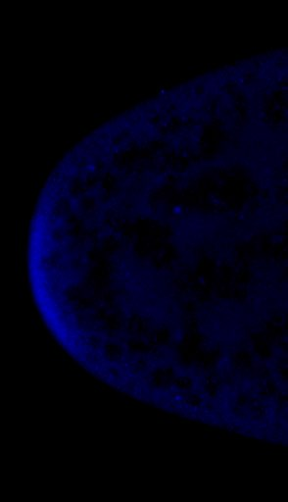
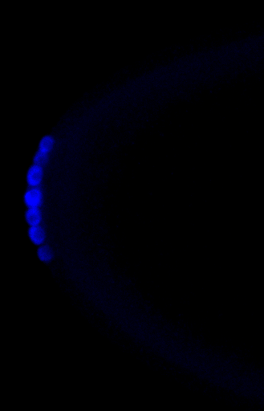

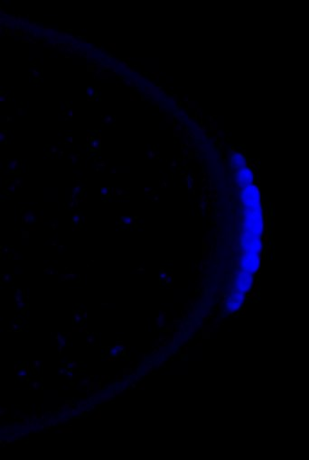

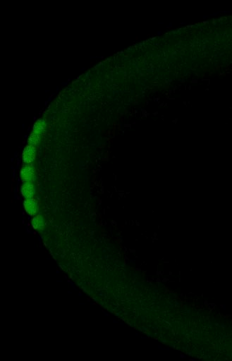
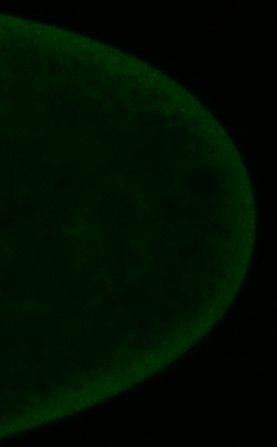
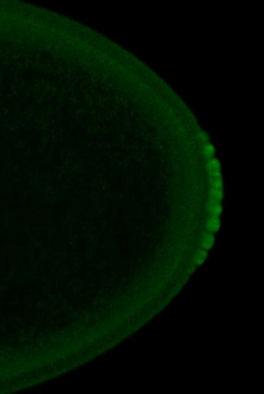
SL10 regulates pgc in the soma
CTRL
dSL10
Stage 2
Stage 6
Stage 2
Stage 6
Embryogenesis
Stage 2
Stage 6
Vasa
Vasa
Vasa
Vasa
CTRL
dSL10
GFP
GFP
GFP
GFP
Notes:
What is special about SL10?

Slide 17
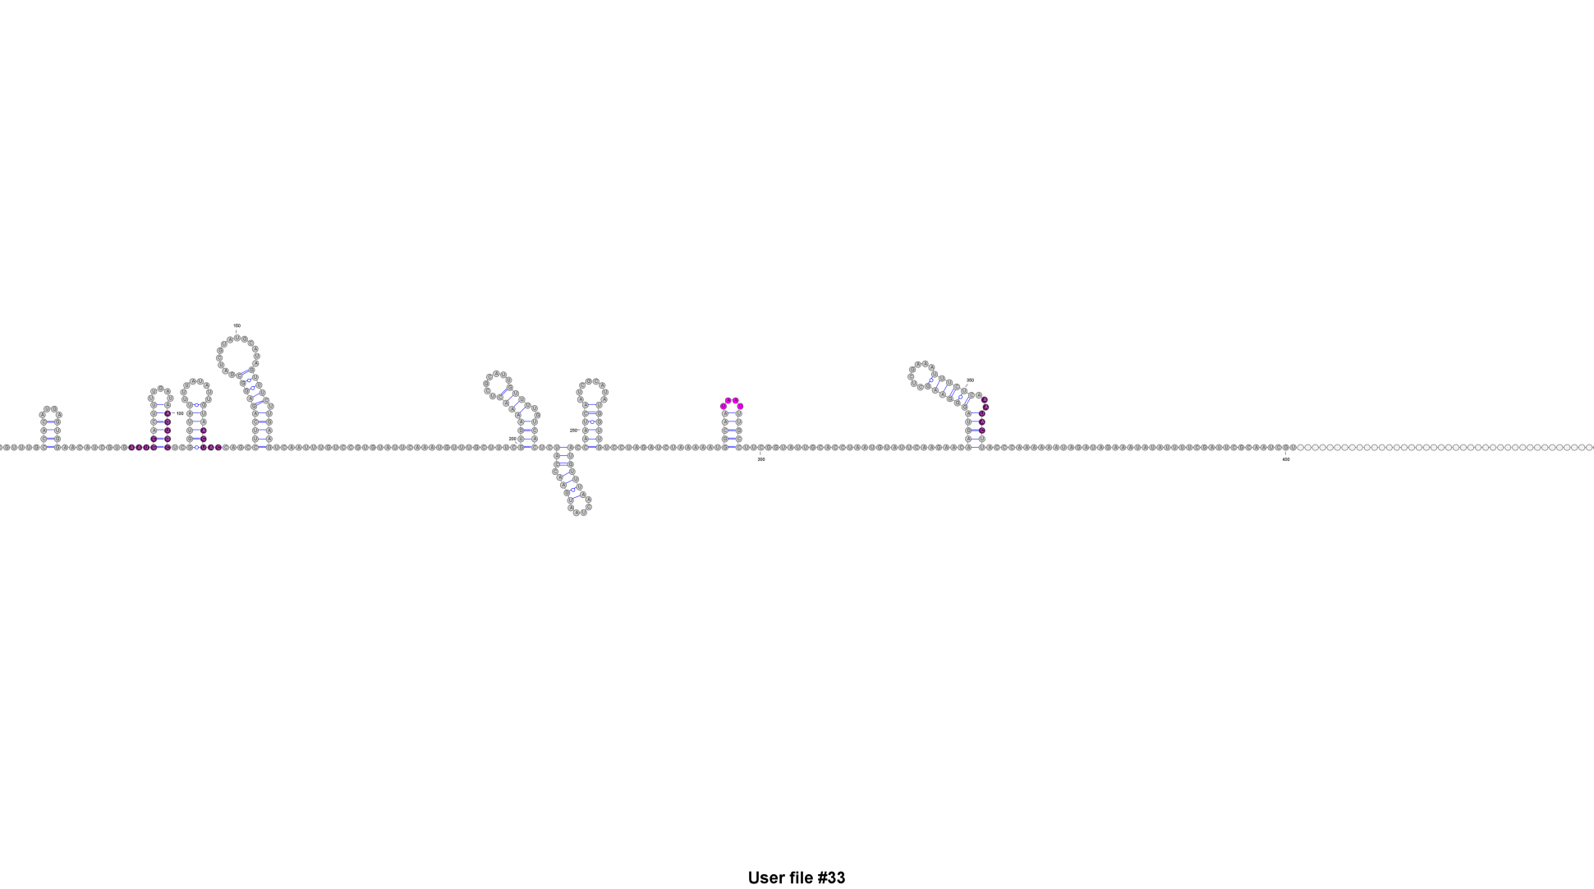

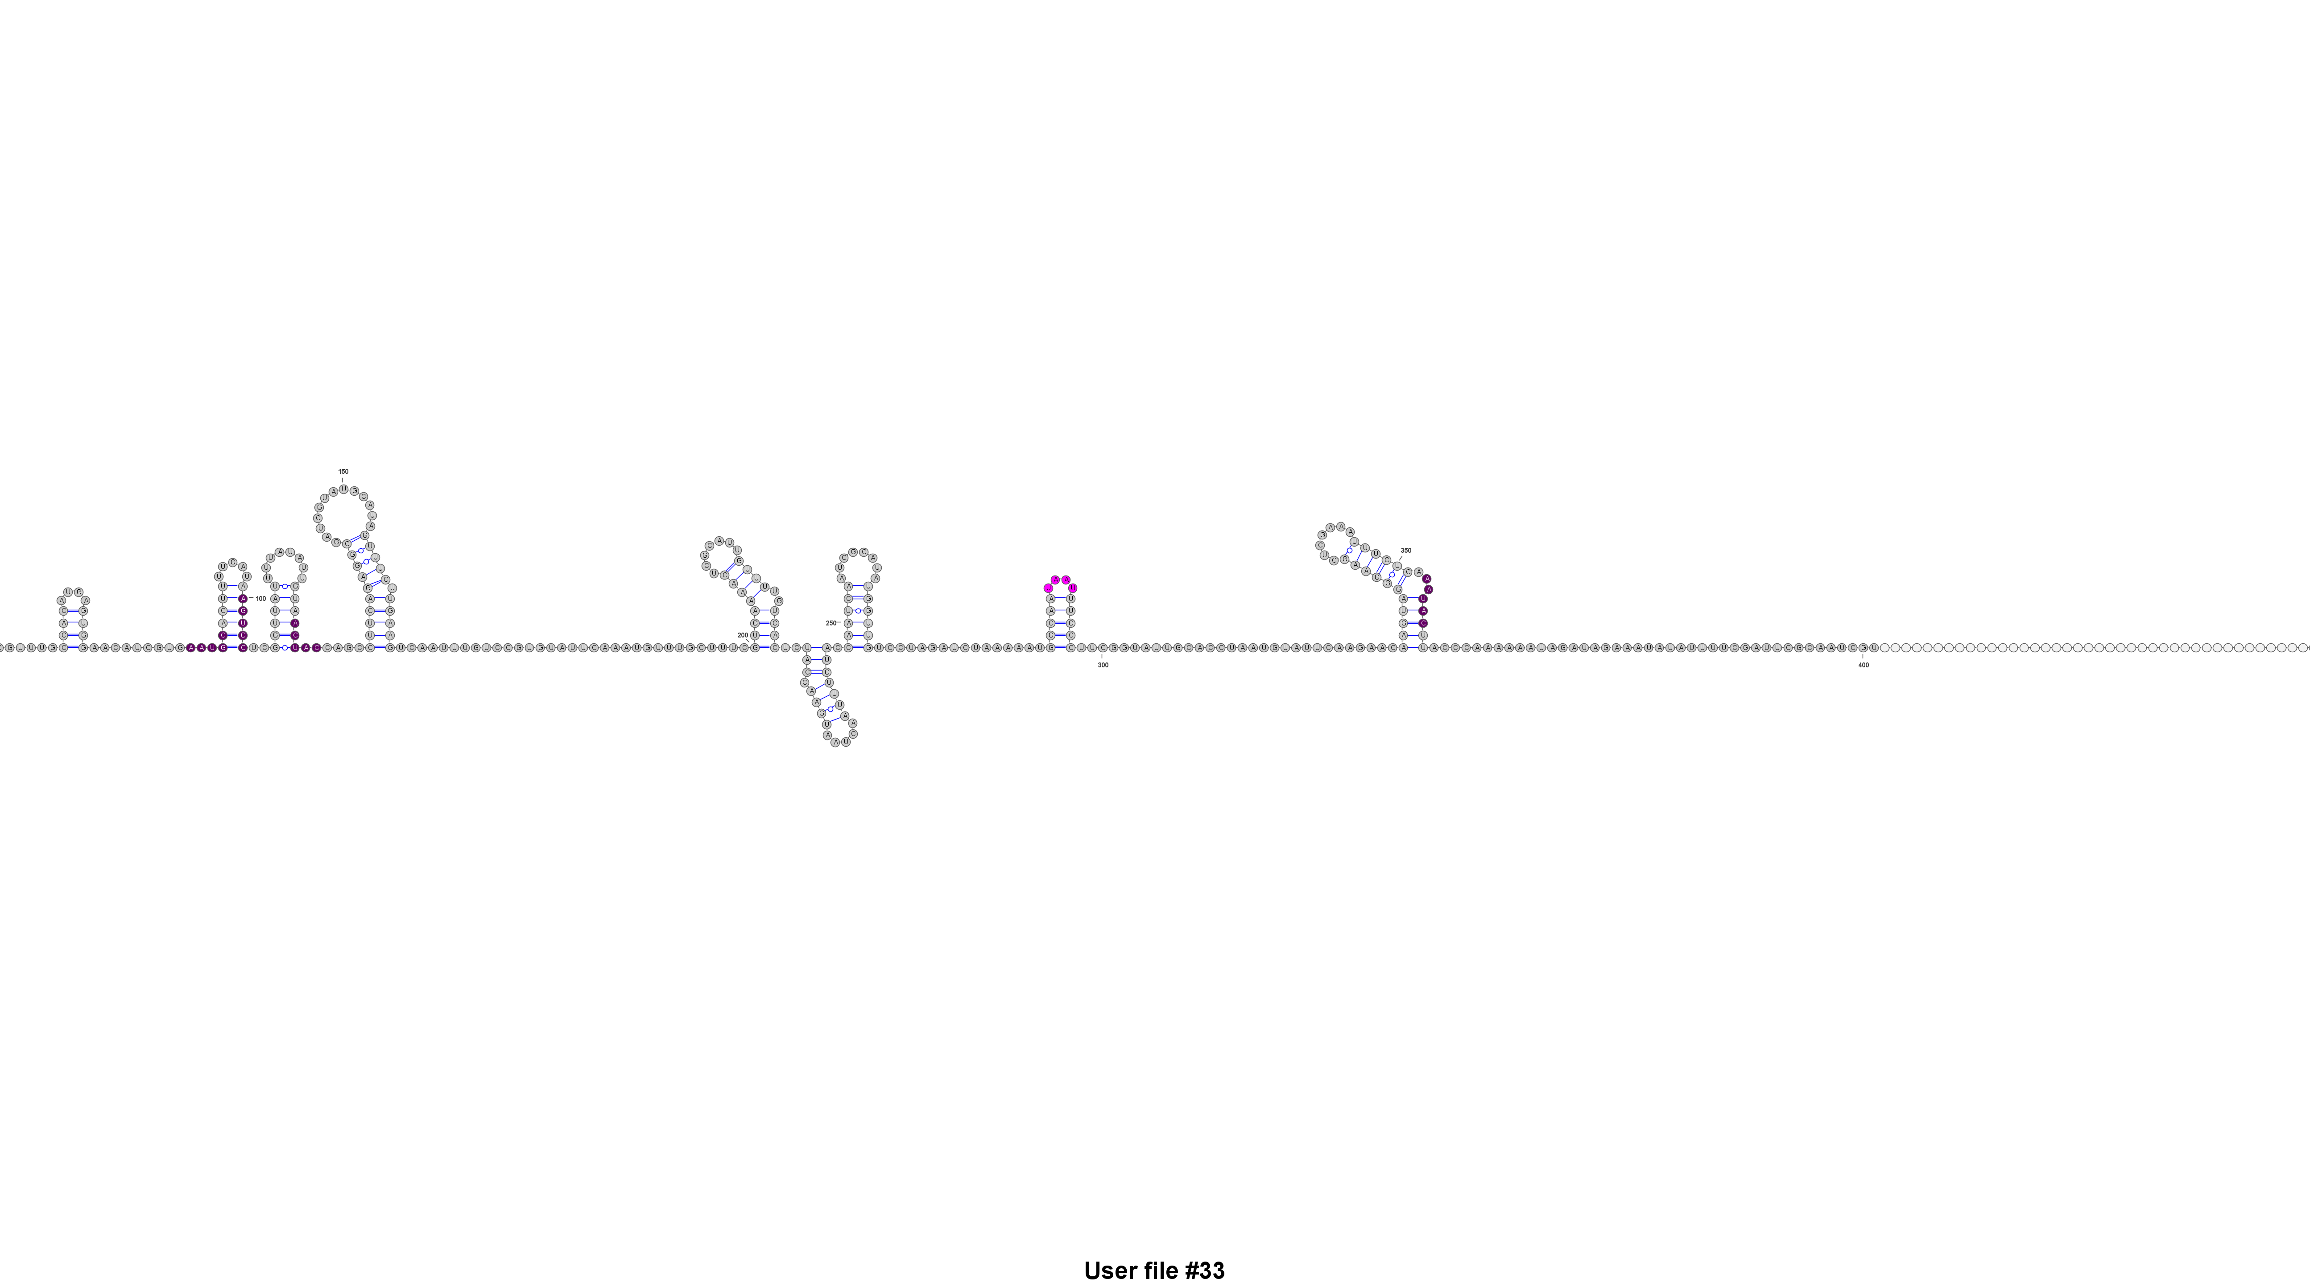
The 3’UTR of pgc has several putative YTH binding sites
SELEX-Consensus of a YTH protein
SL10
Zhang et al, Journal of Biological Chemistry (2010)
Notes:
start end width
[1] 3 6 [GGAC]
[2] 75 78 [GAAC]
[3] 204 207 [AAAC]
[4] 324 327 [GAAC]

Slide 18
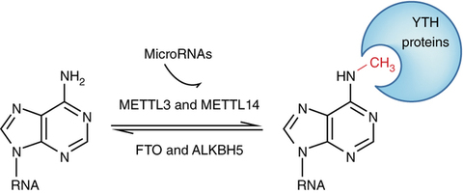
m⁶A is a well characterized mRNA modification
Liu, et al., Nature Structural & Molecular Biology (2016)

Slide 19
YTH proteins can degrade its target RNAs
YTH
Deadenylase Complex
CNOT1
m7G
m⁶A
AAAA
Du et al., Nature Communications (2016)

Slide 20
YTH proteins could act to specifically degrade pgc in the soma
mRNA
No m⁶A
m⁶A
Time
YTH
No YTH
Batista et al., Cell Stem Cell (2014)

Slide 21
Predictions
m⁶A will be detectable on pgc RNA
Loss of m⁶A readers may affect Pgc expression

Slide 22
We can detect m⁶A on pgc
1a) Reverse transcription assay
1b) Mass spectroscopy
1c) m⁶A sequencing

Slide 23
1A) Detection of m⁶A via RTase pausing
Full Length Product

Slide 24
Detection of m⁶A via RTase pausing
Short Product
m⁶A

Slide 25
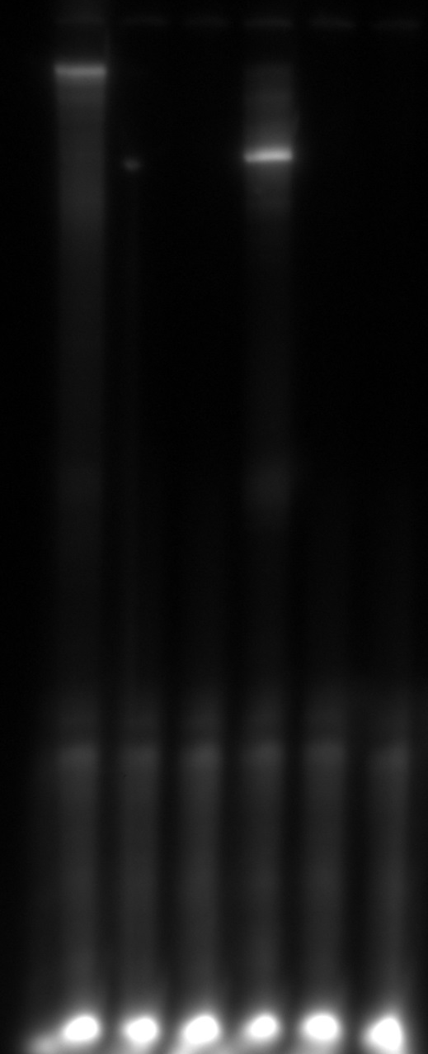
pgc is modified or has strong secondary structure
1X dNTP s
0.01X dNTP s
Control:
In-Vitro transcribed pgc

Slide 26
1B) pgc Pulldown for LS/MS
Streptavidin coated beads
Target RNA
Washing/Elution
Mass Spectroscopy
Biotinylated Oligo

Slide 27
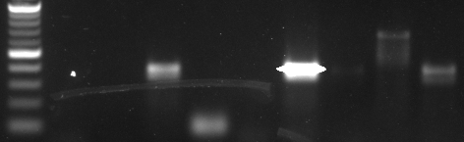
An oligo-based pulldown enriches for pgc
Input
Eluate
M
rRNA
actin
rRNA
pgc
actin
pgc
1000
500
100

Slide 28
m⁶A modified RNAs are present during embryogenesis
m⁶A RNA

Slide 29
1C) m⁶A sequencing of early embryos
m⁶A Pulldown
RNAse T1 Digestion
RNA-seq
m⁶A
m⁶A
m⁶A

Slide 30
Are m⁶A readers acting directly on pgc?

Slide 31
SL10 may be a target for binding of a YTH protein
Oogenesis
Embryogenesis
WT
∆SL10
CG6422
RNAi

Slide 32
Model of pgc regulation in the soma
YTH
m⁶A
Degradation

Slide 33
Future Directions
Repeat primer extension assay
Perform mass-spec of endogenous pgc RNA to determine what modifications are present
Scale up RNA collection and perform m⁶A-seq

Slide 34
Future directions
Determine if knockdown of m⁶A readers and writers have aberrant Pgc expression
Demonstrate that an m⁶A in the 3’UTR is sufficient to provoke degradation of mRNA in the soma during embryogenesis

Slide 35
Aims
Determine how modifications on mRNA direct their regulation
Identify the enzymes that modify ribosomal proteins to affect translation control

Slide 36
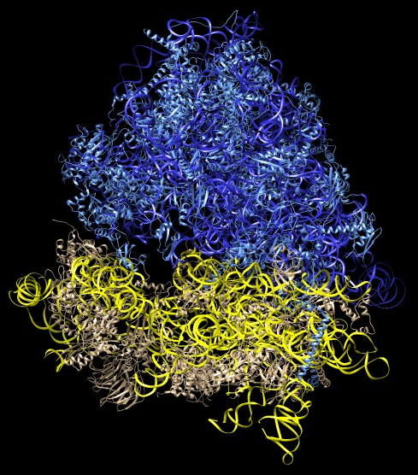
Ribosomes are macromolecular machines
Anger, Current Biology (2013)

Slide 37
Ribosomes are diverse ribonucleoproteins
Core Ribosomal Protein
Variant 1
Variant 2
No modification
Acetylation
Ubiquitinylation

Slide 38
Post-translational modifications in RPS25 are altered during polio infection
Ribosomal Protein Lysine position | Uninfected % of peptides modified | PV-infected % of peptides modified
RPS25 K43 | 7.1 | 0
RPS25 K52 | 0.0 | 0
RPS25 K57 | 5.0 | 0
RPS25 K66 | 8.2 | 100
RPS25 K98 | 0 | 0
Fuchs, in progress

Slide 39
Ribosomal proteins have the same type of modifications as histone tails
No modification
Acetylation
Ubiquitinylation

Slide 40
Ribosomal protein modifications can be deposited by chromatin modifying enzymes
GCN5
GCN5 is a histone acetyltransferase
Downey and Toczyski, Current Biology (2013)

Slide 41
How can we efficiently screen for enzymes that modify ribosomal proteins?

Slide 42
Initiation is the rate limiting step of translation
40S
m7G
eIF4E
eIF4A
eIF4G
PABP
AAAA

Slide 43
Using ribosomal initiation as a read-out
40S
m7G
eIF4E
eIF4A
eIF4G
PABP
AAAA
Cap-Dependent

Slide 44
Using ribosomal initiation as a read-out
40S
m7G
eIF4E
eIF4A
eIF4G
PABP
AAAA
Cap-Dependent
Cap-Independent

Slide 45
Using ribosomal initiation as a read-out
40S
Cap-Dependent
Cap-Independent

Slide 46
Bi-cistronic translation reporter to detect change in ribosome preference
Read-
through stop
IRES
Promoter
5’ UTR
Renilla Luciferase
Firefly Luciferase
3’ UTR
Cap-Dependent
Cap-Independent

Slide 47
Dual Renilla-Firefly Luciferase Assay
Firefly
Substrate
Renilla
Substrate
Germline Reporter
Germline RNAi
Ovary Lysate

Slide 48
Firefly luciferase does not express above background in a reporter fly
Cap-Dependent
Cap-Independent
Notes:
…another way of looking at this is to look at the ratio of the 18ul readout to the 2ul readout

Slide 49
Renilla, but not Firefly luciferase expresses from a reporter fly
Cap-Dependent
Cap-Independent

Slide 50
Potential explanations for low Firefly Luciferase expression
IRES doesn’t express in the germ line
issue with construct
IRES mediated translation is repressed in the germ line
Degradation of the RNA from the 3’ end
qRT-PCR for each ORF

Slide 51
Firefly Luciferase from our construct does not express in a Drosophila cell line
S2 Cells
Cap-Dependent
Cap-Independent
Notes:
To test if there is an issue with the construct we made, I transfected the transcript into a drosophila cell line, with a control construct to compare to.
What you’re looking at again is the fold change in luciferase luminescence, this time from a high concentration of transcript to a low concentration of transcript.

Slide 52
Initiation of the IRES may require a proper leader peptide
Read-
through stop
IRES
5’ UTR
Renilla Luciferase
Firefly Luciferase
3’ UTR
Cap-Dependent
Cap-Independent
A T F Q D T M
A T F Q D S M P M
Notes:
Firefly expression can be a control
Start codon mutant

Slide 53
There are over 100 histone modifying proteins with RNAi lines
rept
EscL
CG9293
Ataxn7
Hmt4-20
Mes4
esc
Set2
Su(z)12
Elp3
Usp36
E(Pc)
rept
mof
Rbp4
YL-1
nej
Art4
Sus1(e(y)2)
Wdr82
upSET
CG1894
nsl1
(wah)
sce
Bre1
Acf1
CG4565
dom
Wda
CG7137
Rbbp5
Sgf11
Mrg15
Art1
Asx
Usp7
mle
E(z)
Tip60
G9a
Taf10
Sirt6
CG14222
Taf1
eco
CG11539
Sir2
Sirt4
Hdac6
dKDM5
Shprh
Gpp
Saf6
Art8
Ash1
enok
trr
msl3
Su(var)3-9
msl1
pr-SET7
CG2051
Caf1
chm
Setdb1
msl2
Eaf6
Set1
Hdac3
Hdac4
Lsd1
Tra1
Spt7 (comr)
Spt3
Ubp8
(not)
Ada2b
Rpd3
Taf5
Taf6
Taf9
(e(y)1)
Taf12
Mocs2
D12
NC2β
Chrac14
Sgf29
Ada2a
Atac2
Hcf1
Wds
Gcn5
Atac3
Ada3
Atac1
Notes:
To do this we used over 100 transgenic lines and stained for developmental phenotypes. In white are those without a phenotype, while those in color were hits, when knocked down within the germline. But, what was most interesting to us were those in green…those that are in green are hits from histone modifying complex called ATAC.
Because ATAC complex members showed defects in oogenesis when they were knocked down in the germline, we wanted to further investigate the role of ATAC during oogenesis.

Slide 54
Many of these lines have developmental defects
rept
EscL
CG9293
Ataxn7
Hmt4-20
Mes4
esc
Set2
Su(z)12
Elp3
Usp36
E(Pc)
rept
mof
Rbp4
YL-1
nej
Art4
Sus1(e(y)2)
Hdac6
Wdr82
upSET
CG1894
nsl1
(wah)
sce
Bre1
Acf1
CG4565
dom
Wda
CG7137
Rbbp5
Sgf11
Mrg15
Art1
Asx
Usp7
mle
E(z)
Tip60
G9a
Taf10
Sirt6
CG14222
Taf1
eco
CG11539
Sir2
Sirt4
dKDM5
Shprh
Gpp
Saf6
Art8
Ash1
enok
trr
msl3
Su(var)3-9
msl1
pr-SET7
CG2051
Caf1
chm
Setdb1
msl2
Eaf6
Set1
Hdac3
Hdac4
Lsd1
Tra1
Spt7 (comr)
Spt3
Ubp8
(not)
Ada2b
Rpd3
Taf5
Taf6
Taf9
(e(y)1)
Taf12
Mocs2
D12
NC2β
Chrac14
Sgf29
Ada2a
Atac2
Hcf1
Wds
Gcn5
Atac3
Ada3
Atac1
No morphological phenotype
Germ line morophological
phenotype
Notes:
To do this we used over 100 transgenic lines and stained for developmental phenotypes. In white are those without a phenotype, while those in color were hits, when knocked down within the germline. But, what was most interesting to us were those in green…those that are in green are hits from histone modifying complex called ATAC.
Because ATAC complex members showed defects in oogenesis when they were knocked down in the germline, we wanted to further investigate the role of ATAC during oogenesis.

Slide 55
Summary
m⁶A may play a role in translation control of pgc
A dual-luciferase construct can allow us to screen for enzymes that modify ribosomal proteins

Slide 56
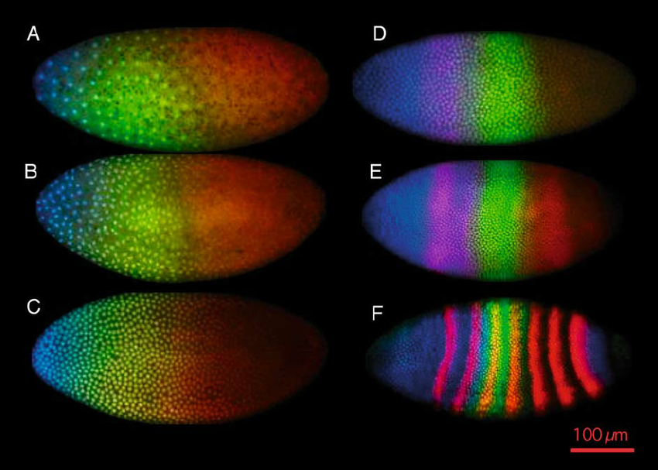
Fritsch et al., Chromosome Research (2006)
Notes:
Overall, our long-term vision for these projects is to be able to understand how diversity, imparted through either post-transcriptional or post-translational modifications can control translation. One beautiful example is the translation control that occurs during early drosophila embryogenesis. Despite the lack of any cytoplasmic division in early embryos and the lack of any transcription control, RNAs begin to localize forming complex patterning which sets up the early drosophila embryo for later development.

Slide 57



Acknowledgements
Rangan lab
Prashanth Rangan
Katarína Tlučková
Siu-Wah Wong-Deyrup
Pooja Flora
Maitreyi Upadhyay
Alicia McCarthy
Patrick Blatt
Michael Kuna
Dhruv Patel
Mohamad Nasrallah
Tyler Pocchiari
Mehmet Ozturk
Grace Hren
Scott Venturino
Fuchs lab
Gabriele Fuchs
Clare Miller
Priyanka Sehta
Nick Peterson
Yasith De Silva
Tomi Alade
James Lee
RNA Institute
K. Halvorsen
S. Ranganathan
S. Vangaveti
Fabris lab
D. Fabris
R. Nemati
T. Kenderdine

Slide 60



m⁶A is a dynamic mark
Reader
Eraser
Writer
m⁶A
Cap
5’UTR
Exon
3’UTR
AAAAAAn

Slide 61
Ribonucleproteins are recruited by sequence and structure
G
A
G
C
G
G
A
C

Slide 62
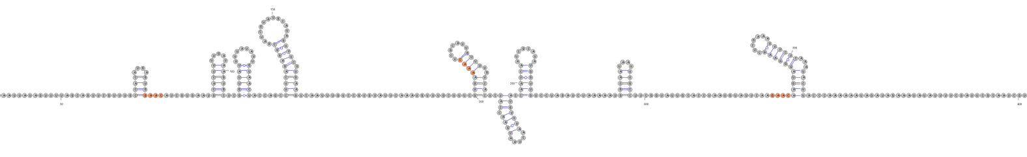
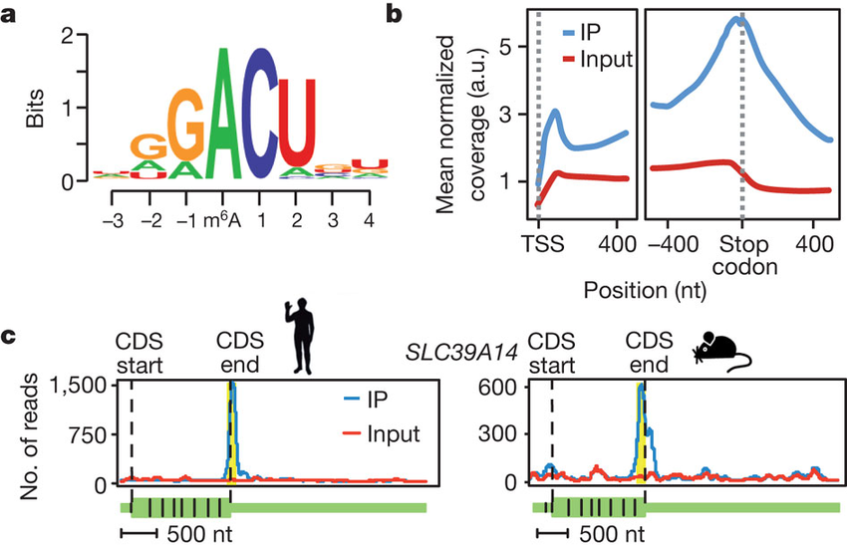
The 3’UTR of pgc has several putative methylation and YTH binding sites
YTH Consensus
SL10
m⁶A Consensus
Notes:
start end width
[1] 3 6 [GGAC]
[2] 75 78 [GAAC]
[3] 204 207 [AAAC]
[4] 324 327 [GAAC]

Slide 63
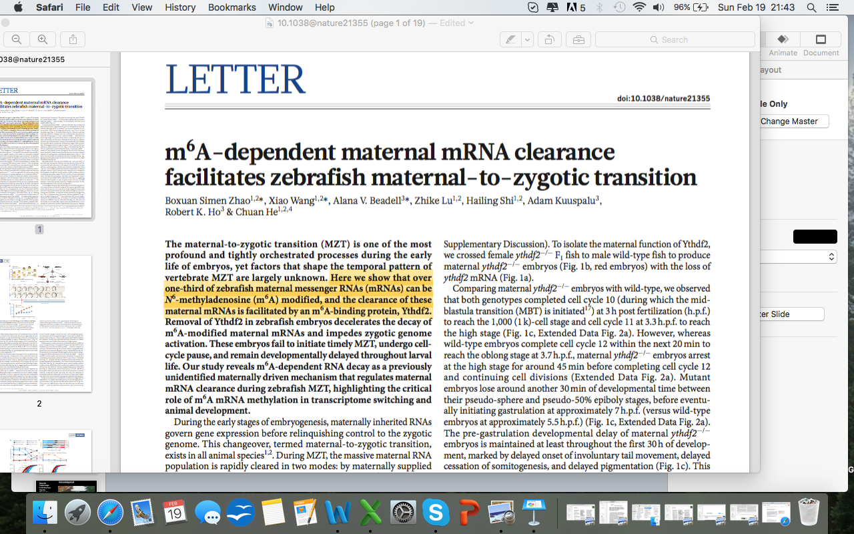

Slide 64
Germline determinants are segregated during development
Mammals
Drosophila

Slide 65
m⁶A readers affect transcript expression
Reader
Reader
m⁶A
Cap
5’UTR
Exon
3’UTR
AAAAAAn
Translation
Degradation
Splicing

Slide 66
Ribosomes are diverse ribonucleoprotein machines
Ribosomal Proteins
Ribosomal Protein Modifications
rRNA Modifications

Slide 67
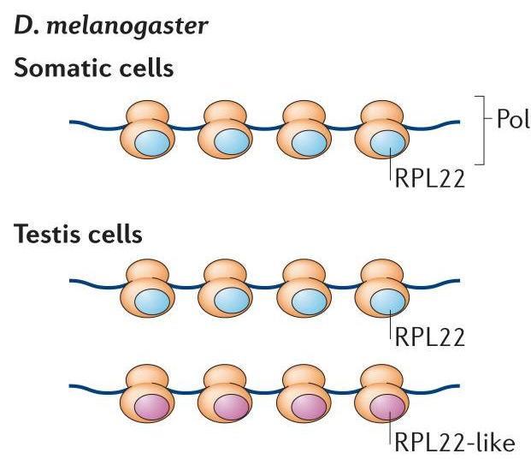
Ribosomal heterogeneity can be cell type specific
Michael G. Kearse, Alex S. Chen, and Vassie C. Ware

Slide 68
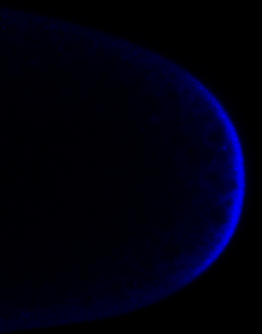
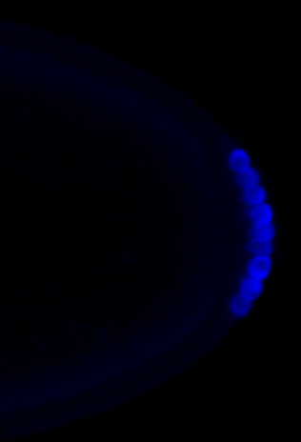
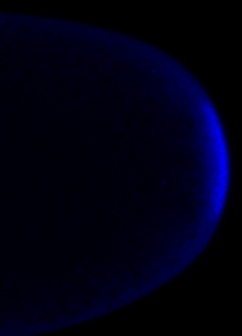
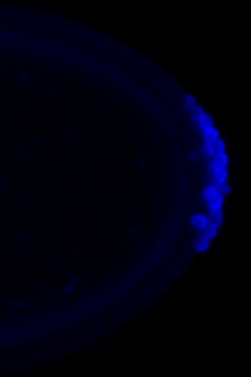
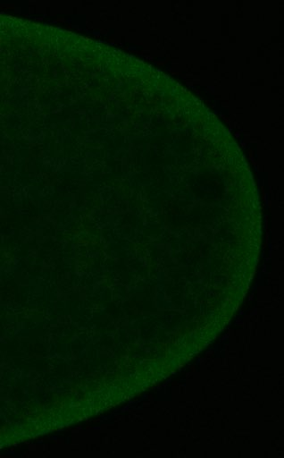
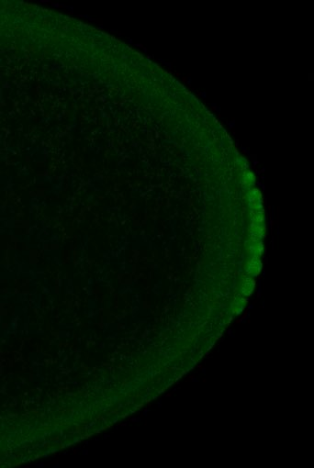
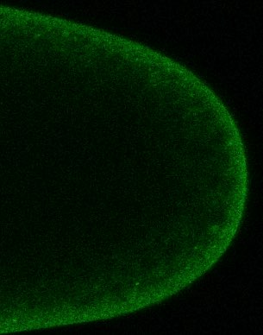
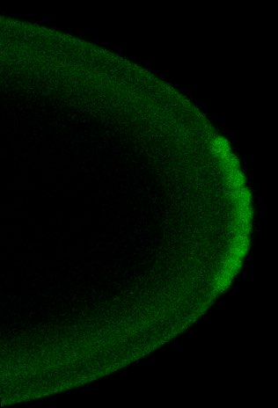
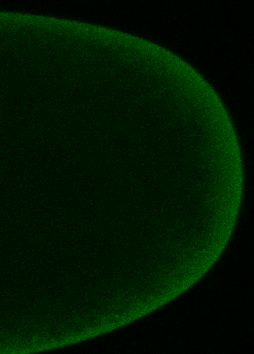
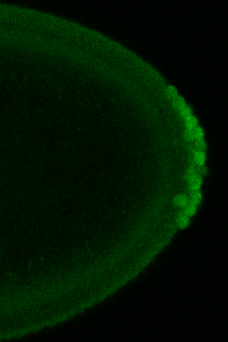
m⁶A readers are required for pgc translation control
C1
dSL10
YT521B RNAi
CG6422 RNAi
Stage 2
Stage 6
Stage 2
Stage 6
Stage 2
Stage 6
Stage 2
Stage 6
Vasa
Vasa
Vasa
Vasa
Vasa
Vasa
Vasa
Vasa
GFP
GFP
GFP
GFP
GFP
GFP
GFP
GFP

Slide 69
Evaluation of pgc Pulldown via RT
Elution at 50°C
Elution at 95°C
Input
M
pgc
actin
rRNA
pgc
actin
rRNA
pgc
actin
rRNA
1000
500
100

